Slide 1

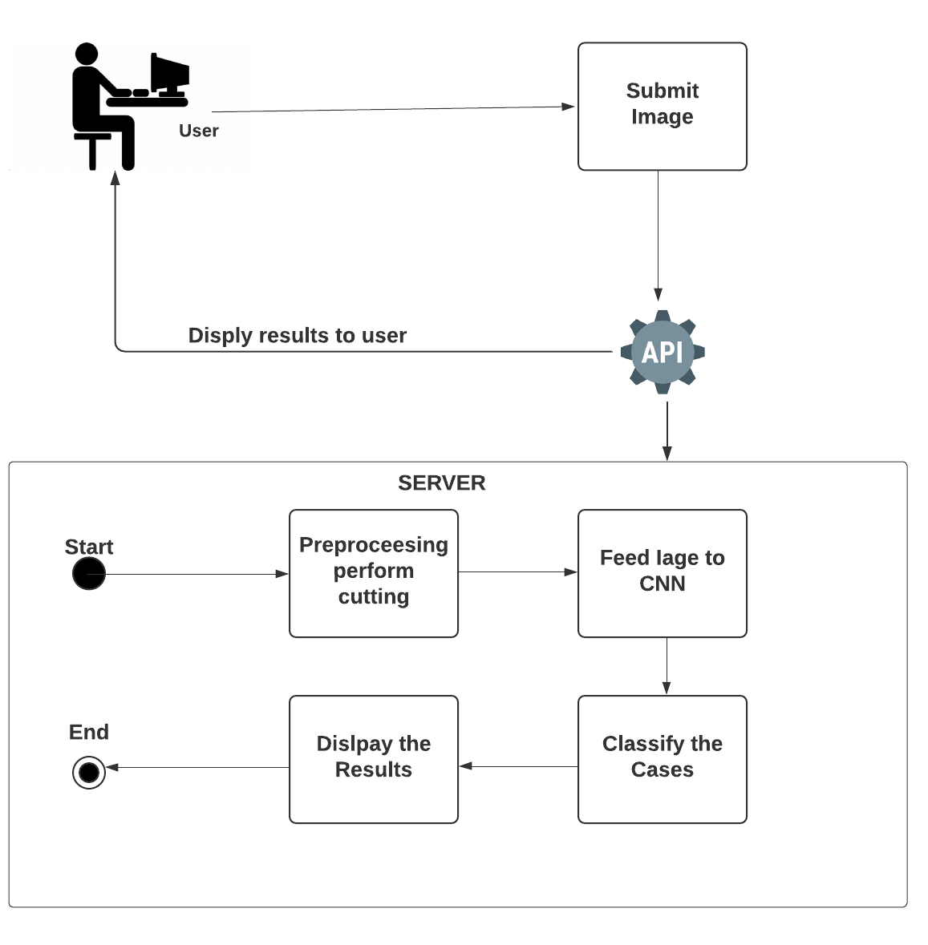
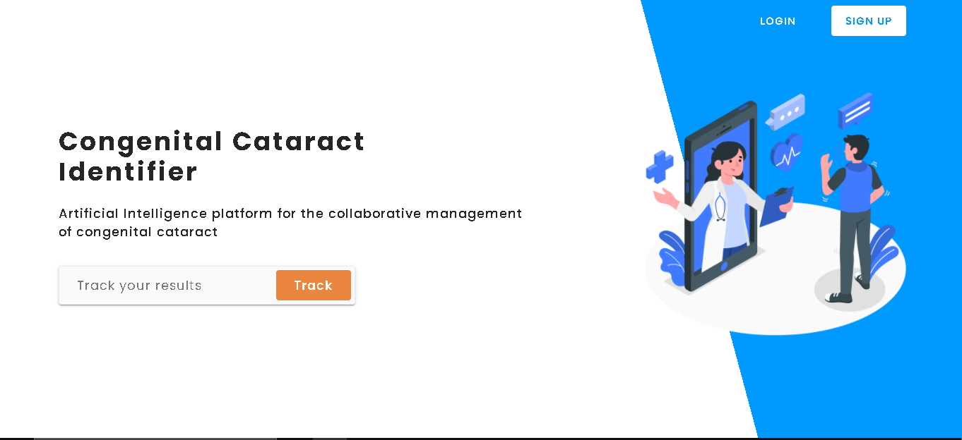
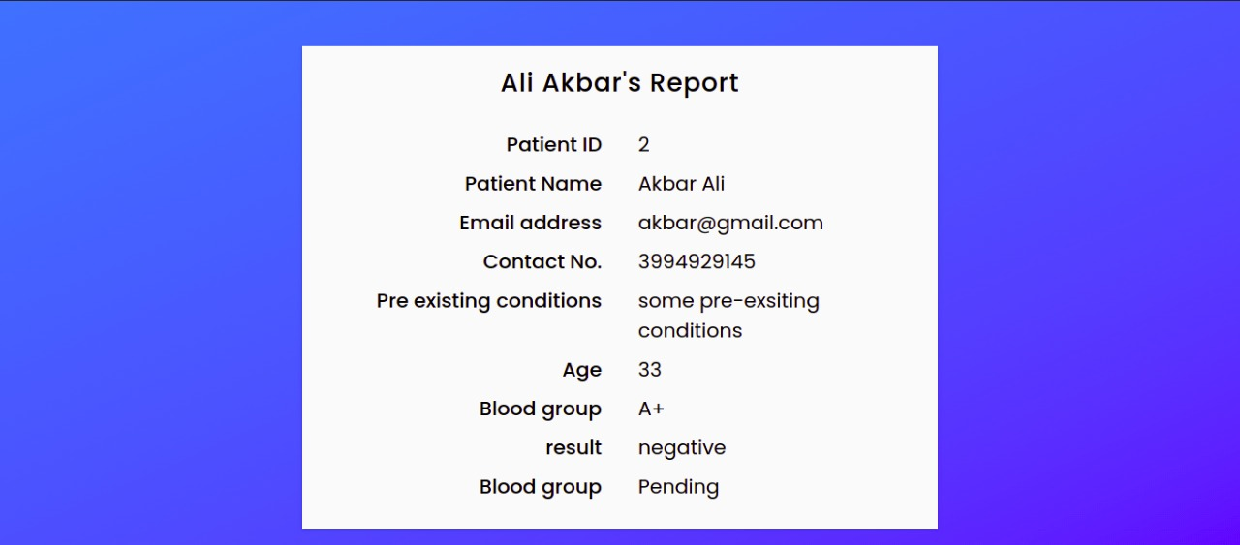


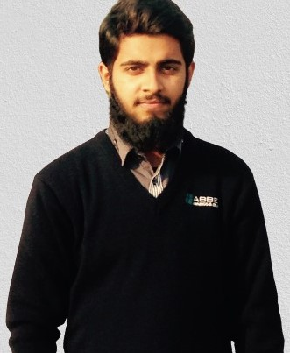
Ai Platform For Collaborative Management Of Congenital Cataract
^{Final Year Project (2017-2021)}
^{Department of Computer Science}
COMSATS University Islamabad, Attock Campus
Introduction
Our project helps to identify the disease Congenital Cataracts. Congenital Cataracts (CC) is a disease which is present mostly in newborn babies and may also develop later, eyes become opaque causing blurry vision or vision loss.Using modern technology, we can identify these rare disease with much better efficiency.
Motivations
Make the hospitals to collaborate on rare disease like Congenital Cataract.
Reduce cost and time in healthcare.
There is no access to specialized clinics in remote areas, so it can cause permanent disability to the patients. So platform like this can provide easy treatment to such area
No third parties between merchant and customer.
System Background
There are some problems with the existing systems which are identified below:
As it is a rare disease and it can be left untreated by human error.
There is no system to identify the congenital cataract.
Architecture
Results
Patient
Patient can view the results using his tracking id and email of the results is also sent once the results are verified.
Conclusion
Congenital caratact can cause permanent blindness to the patient. So platform like CC-Identifier will help in improving the health care. It will reduce cost and time. It will provide easy treatment to the people living in remote areas who do not have access to specialized hospitals or clinics.
Future Directions
As the use of technology is arising in medical field, our project can pursue further integrations.
We’ll develop android application to provide more facility.
User/Doctor/Hospital
User can manage the cases from the dashboard
Objectives
Building a system for a rare disease than can help in determining the disease specially in remote areas like Pakistan.
Implementing the deep learning for mimicking the human behaviour in classifying the different data based on visuals.
Integrating our AI agent for identifying the Congenital Cataract with the web-based application, so that the multiple hospitals can easily collaborate.
Group Members
Zuhaib Khan
Xuhaib002@gmail.com
Hafiz M. Saqib
Saqibnaveed3545@gmail.com
Supervisor:
Mam Tahira Sadaf

